Slide 1

RedRock Seminar
Design Pattern – Prototype and Facade

Slide 2
Prototype Design Pattern
Definition : Specify the kind of objects to create using a prototypical instance, and create new objects by copying this prototype
“Don't reinvent the wheel“- User will be ‘copying/cloning’ the object instead of creating a “new”
This allows as to capture the present state of the original object in its clone
Reduces the need of writing the repetitive code of creating and then copying the object state to the new object.
The prototype design patter indeed does some complex job of creating the deep copy of the object.

Slide 3
Prototype Design Pattern
Participants : The classes and/or objects participating in this pattern are:
  Prototype : Declares an interface for cloning itself
  Concrete Prototype : Implements an operation for cloning itself
  Client : Creates a new object by asking a prototype to clone itself

Slide 4
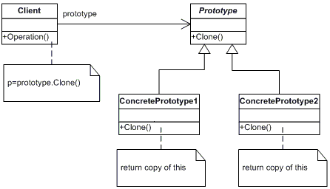
Prototype Design Pattern
UML Diagram

Slide 5
Prototype Design Pattern
Problem 1: A class that cannot be constructed outside the assembly and needs a copy made that keeps its current state intact
Problem 2: Need a prototype method on the class to return a cloned instance with its state copied to the needed depth

Slide 6
Prototype Design Pattern
Problem 1: A class that cannot be constructed outside the assembly and needs a copy made that keeps its current state intact
Problem 2: Need a prototype method on the class to return a cloned instance with its state copied to the needed depth
Solution: Prototype design pattern

Slide 7
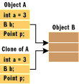
Prototype Design Pattern
What is Cloning?
Cloning is the process of copying an object—the creation of a new instance of a class representing information equivalent to the original instance.
Shallow Copy: Copies only the top level object with it’s primitive members and holds the reference for all child objects
Deep Copy: Copies whole object hierarchy with a new reference all together, but remember “Check the depth before you dive! ”.

Slide 8
Prototype Design Pattern
Cloning in C#
ICloneable: Supports cloning, which creates a new instance of a class with the same value as an existing instance
// Summary:
// Supports cloning, which creates a new instance of a class with // the same value
// as an existing instance.
[ComVisible(true)]
public interface ICloneable
{
// Summary:
// Creates a new object that is a copy of the current //instance.
// Returns:
// A new object that is a copy of this instance.
object Clone();
}

Slide 9
Prototype Design Pattern
ICloneable implementation
class MyCloneable : ICloneable
{
#region ICloneable Members
public object Clone()
{
// Cloning logic goes here…
}
#endregion
}

Slide 10
Prototype Design Pattern
MemberwiseClone: Protected method that represents the ability of all objects to duplicate themselves
Assists us in our implementation of Clone() method and does a shallow copy
public object ShallowClone()
{
// Returns shallow copy
return this.MemberwiseClone();
}

Slide 11
Prototype Design Pattern
Common mistakes in Pattern Literature / Pitfalls to avoid
  Understand the issue of deep and shallow copying.
  Decide whether to do a deep or shallow copy based on how the client uses the concrete-prototype over its lifetime.
  Don't assume that the effort of making a deep copy is a good thing. Make sure that deep copying is both necessary (to avoid incurring unnecessary performance penalties) and correct.

Slide 12
Prototype Design Pattern
.Net Examples of Prototype pattern:
  arryList.Clone()
  cultureInfo.Clone()
  dataSet.Clone() and dataSet.Copy()

Slide 13
Facade Design Pattern
Purpose : Provide a unified interface to a set of interfaces in a subsystem. Façade defines a higher-level interface that makes the subsystem easier to use.
Participants :
  Façade
    Knows which subsystem classes are responsible for a request.
    Delegates client requests to appropriate subsystem objects.
  Subsystem Classes
    Implement subsystem functionality.
    Handle work assigned by the Facade object.
    Have no knowledge of the facade and keep no reference to it.

Slide 14
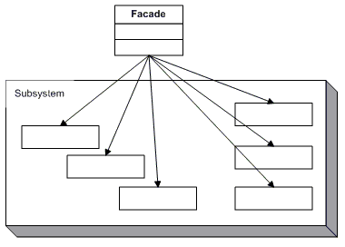
Facade Design Pattern
UML Diagram

Slide 15
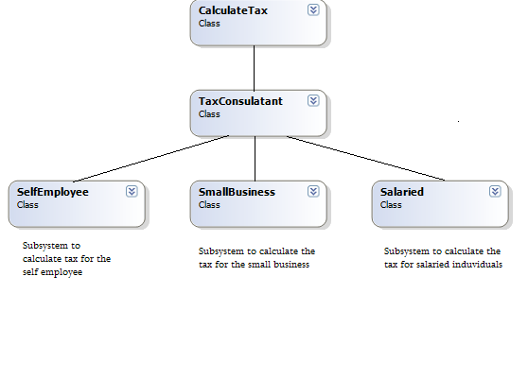
Facade Design Pattern
Façade Example

Slide 16
Facade Design Pattern
Facade Benefits
Façade is an hub for accessing controlled subsystem in side an assembly
Face encapsulate the calling order of each class in a subsystem
.Net Examples of Facade Pattern
ADO.NET
System.Environment

Slide 17
Resources
Books
  Design Patterns – GOF
  Design Patterns – Christpher G Lasater
  Head First Design Patterns

Slide 18
Questions
If (Questions == null || Questions.Count == 0)
{
Thank you;
}

